Slide 1

Hybrid Telco Churn and Geospatial Risk Analysis
Sikawura Kobina Ebo Arkorful April 2026

Slide 2
Content
Executive Summary
Understanding Churn
The Hybrid Solution & Methodology
Validating the Hybrid Model
Strategic Recommendations & Next Steps

Slide 3
Executive Summary
The Hybrid Telco Churn model improved churn prediction by integrating local infrastructure health (Signal and Outages) with traditional billing data. The Hybrid approach achieved an ROC-AUC score of 84%, proven that poor service quality is a ‘silent’ driver of customer loss.

Slide 4
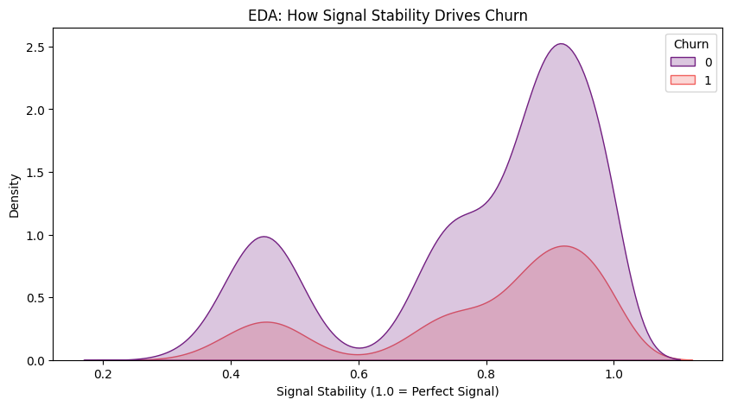
Understanding Churn
Why Traditional Churn Models Are Incomplete.
The standard models only look at what customers pay (contracts/charges) and underplay the significance of network stability and outages.
The Gap: They ignore the physical environment (signal strength and outages).
The Density Plot, as shown on the right, proves that poor signal quality is a leading cause of customer frustration.

Slide 5

The Hybrid Solution & Methodology
Mapping the "Geospatial Risk" Layer.
Data Enrichment: I didn’t just look at customer profiles; I added a Signal Stability Index. This maps physical infrastructure health directly to the individual account
Feature Engineering: I used a Random Forest model.
The model identifies "Double Jeopardy" customers—those on flexible contracts who also live in high-outage ZIP codes.

Slide 6
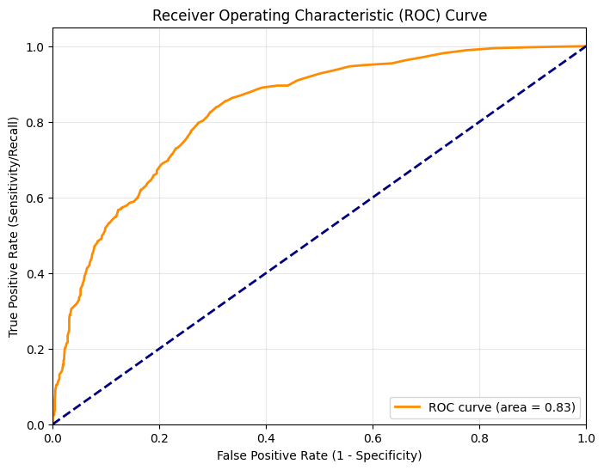
Validating the Hybrid Model I. ROC-AUC of 0.84 and 80% accuracy.
Metric | Score | Interpretation
Accuracy | 80% | High overall predictive reliability.
ROC-AUC | 0.84 | Excellent ability to distinguish churn risk tiers.
Precision (Churn) | 0.66 | 2 out of 3 "at-risk" flags are accurate hits.
Recall (Churn) | 0.49 | Successfully captured nearly half of all actual churners.

Slide 7
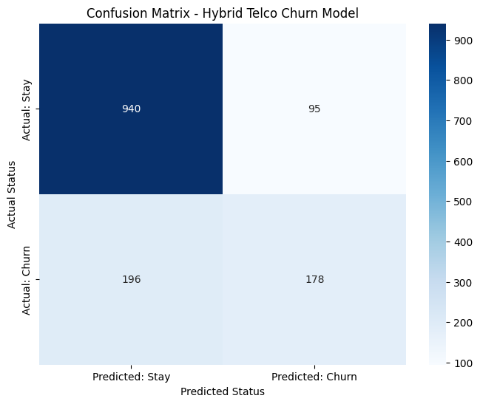
II. The Confusion Matrix shows the "Hit Rate" for churners.

Slide 8
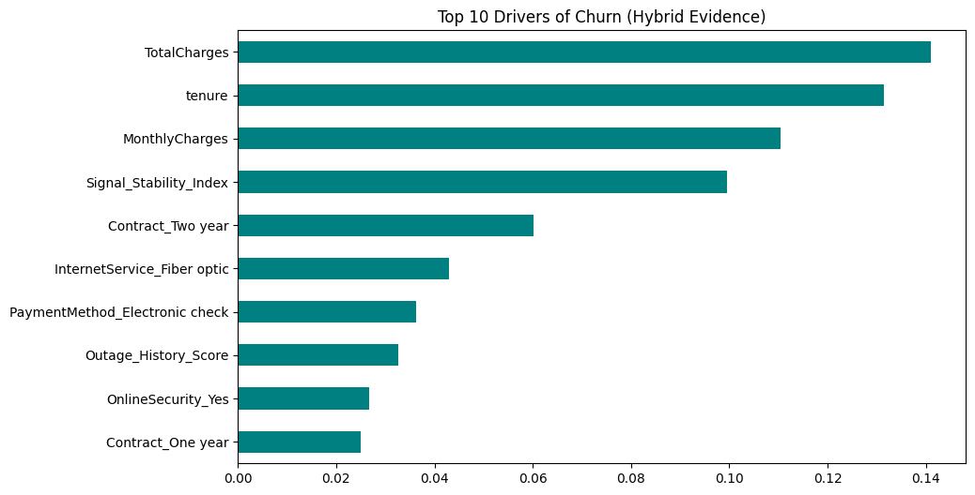
III. The feature Importance plot points out that the Signal Stability Index is a Top 5 driver, proving that infrastructure is a "silent" driver of churn.

Slide 9
Strategic Recommendations & Next Steps
Investing in infrastructure
Regular monitoring of the geospatial metrics
Customer engagement
Consider rolling out loyalty programs

Slide 10
I end my presentation with this: "Data-driven infrastructure leads to customer-driven loyalty".
Thank you!

